Slide 1
Security Scan for OpenStack
Demo 2
9 February 2018
Clara De Paolis
Dilip Makwana
Hao Wu
Chi Zhang

Slide 2
Progress since Last Demo
Our user
Any client using Trilio Vault backup system
Setup VMs on MOC
Current working on scanning within one VM
Received sample data from Trilio
One workload, including 4 snapshot, each with 3~4 VMs
Discarded UI design. Focus more on scanning and scaling
“New” requirement
Scan many snapshots simultaneously
Notes:
Clara

Slide 3
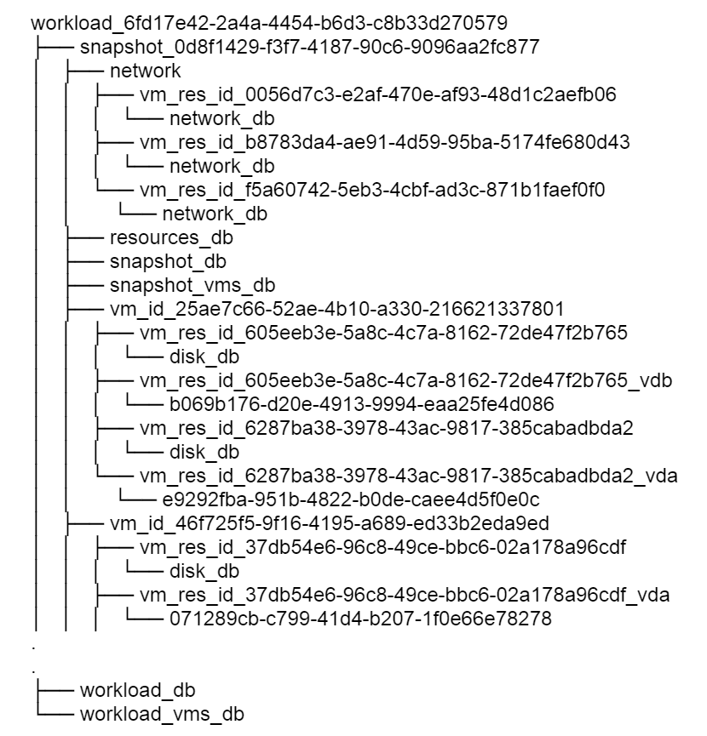
New Information from Trilio
Workload is a backup job description. It includes the number of VMs to backup and the interval at which the VMs need to backup.
Under the workload_<workload_uuid> directory, the snapshot_<snapshot_uuid> directory saves a snapshot of the workload.
The VM disk resources are stored under workload_<workload_uuid>/snapshot_<snapshot_uuid>/vm_id_<vm_id>. And the actual backup image files are stored under the xx_vda folder, with the name as a simple id.
The file structure is quite self-explanatory and the metadata contains lots of information. We can either use the information in our security scan or optimize our scanning report.
Notes:
Chi

Slide 4
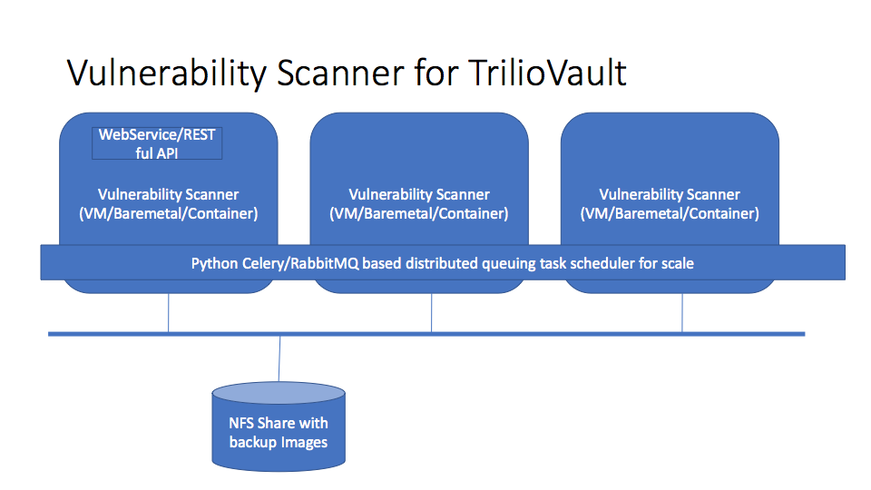
Architecture Design
When backup jobs are done, there might be 1,000 simultaneous scannings, so scalability is important
Scale horizontally by deploying on multiple containers (Trilio recommended OpenShift on MOC)
Use Celery/RabbitMQ to save the scanning tasks, and distribute them across our scanners
Provide a WebService/RESTful API, with which users can get scanning report by providing workload_id and snapshot_id
Notes:
Chi

Slide 5
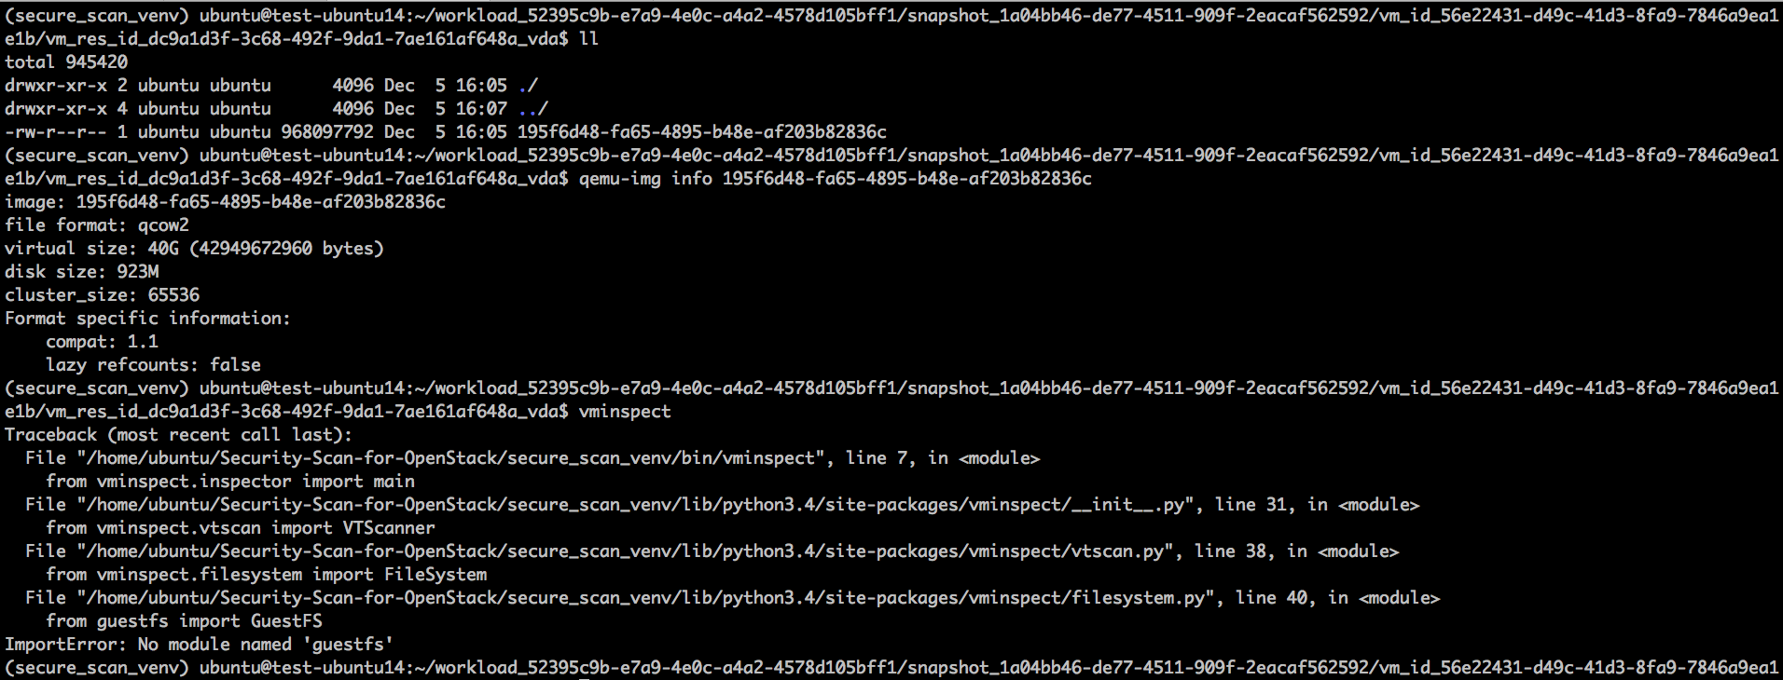
Read in qcow2 file
The format of the backup images is qcow2, a native format for storage vm images on KVM (Kernel-based Virtual Machine). We can use qemu-img command to explore the backup image.
Note:
Trilio mentioned that we should be able to see a property named backing file, which is a reference to the previous snapshot. But there is no such information. Will confirm with them in the next meeting.
Notes:
Dilip

Slide 6
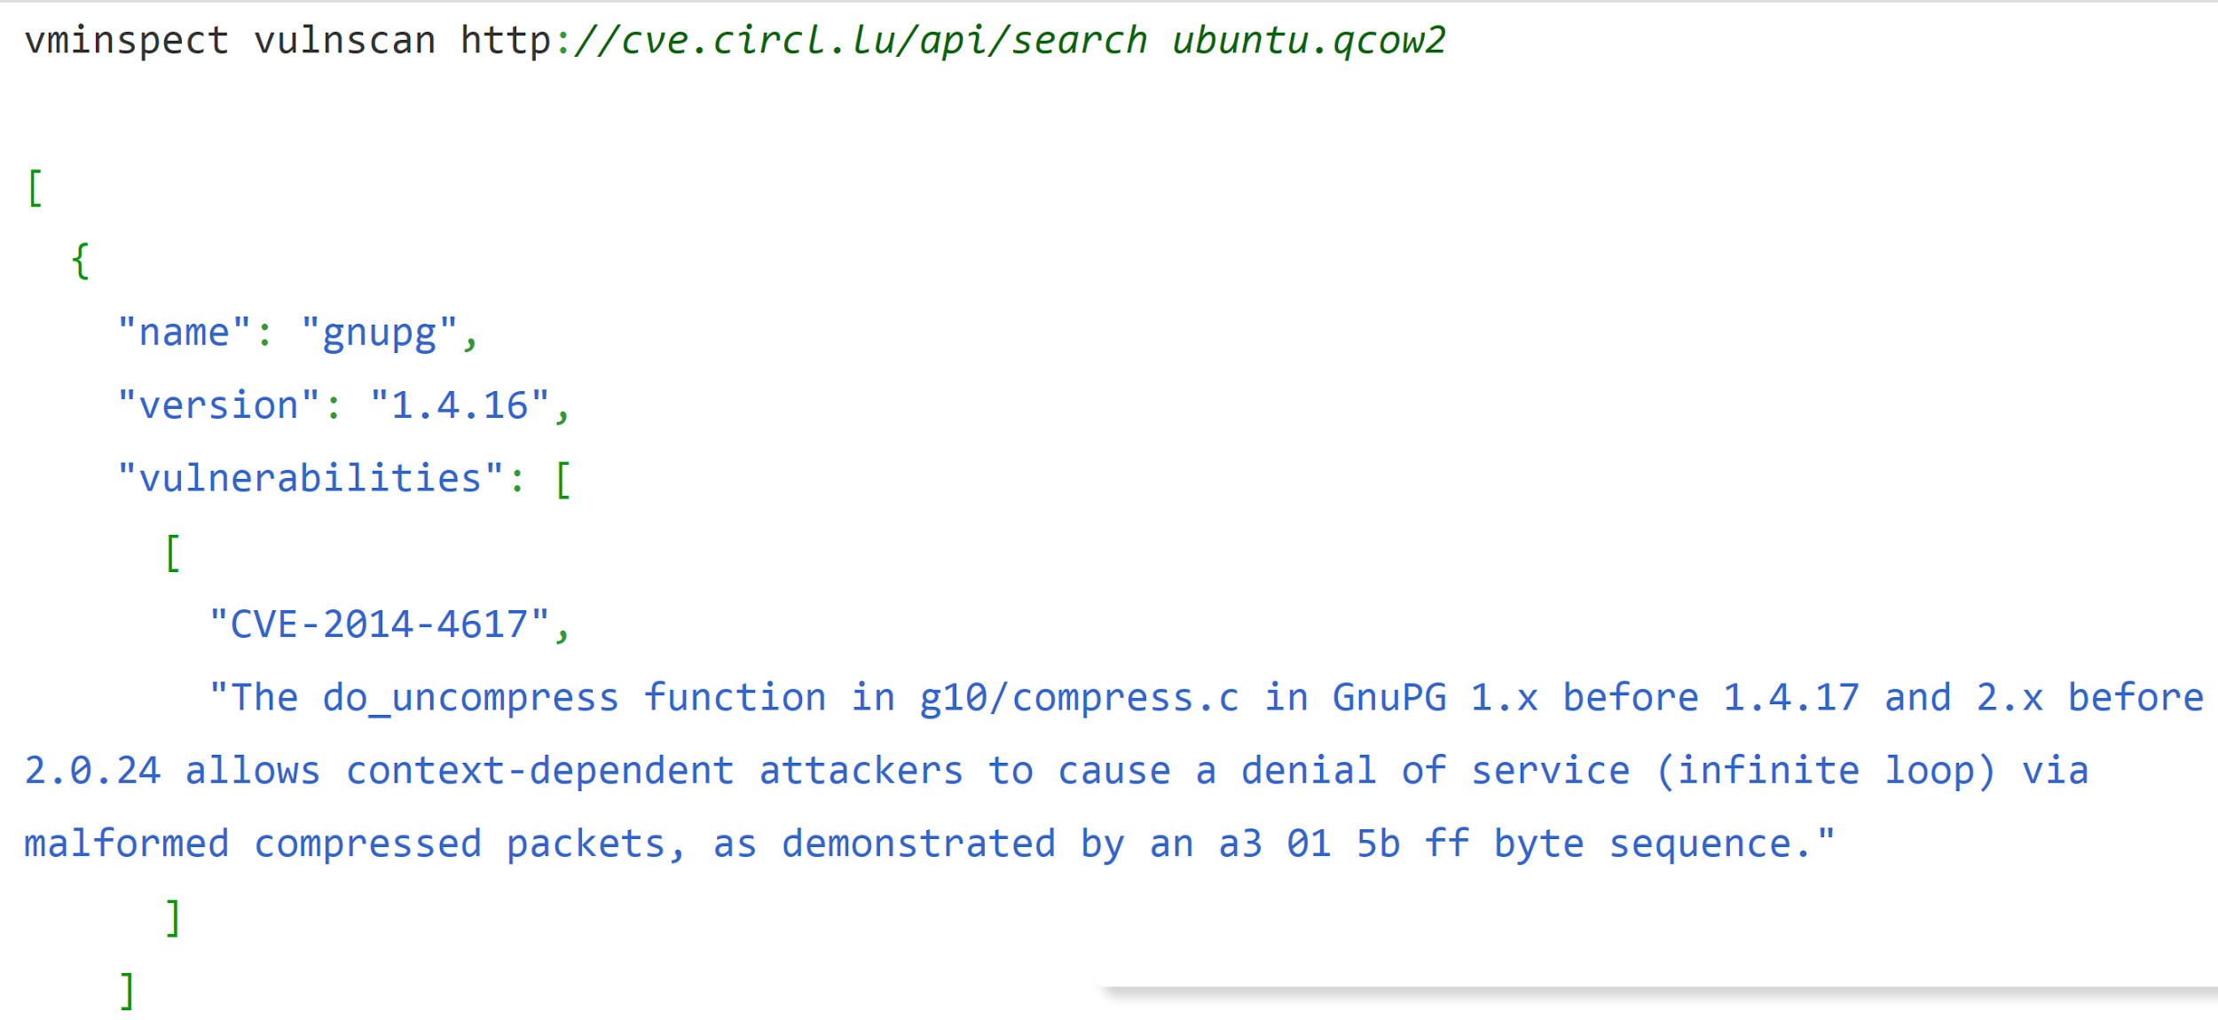
Scanning file (without making image live)
vminspect is a python library for vulnerability scanning and works on qcow images.
Supports for querying CVE database for vulnerable applications against an image
It is based on libguestfs, a C library for accessing virtual disk images
Sample output:
Notes:
Hao

Slide 7
Issues
vminspect and guestfs module:
Notes:
Hao

Slide 8
Timeline
Sprint 1
Sprint 2
Sprint 3
Sprint 4
Sprint 5
Sprint 6
Sprint 7
Accessing Trilio Backups
Vulnerability scanning
Evaluate scans
API implementation
Final improvements
Planning
Scale up the scanning solution
Design, implement and test RESTful API
Generate a user friendly report based on the scanning result using data visualization tools
1. Project proposal
2. Identify Service goals/requirements
3. Research related security scanning technologies, libraries, and tools.
1. Set up a POC environment on Mass Open Cloud
2. Access snapshots and understand how to work with the POC environment
1. Decision: make images live before scanning?
2. Scan snapshots to understand cloud environment when snapshot was taken
Evaluate different vulnerability scanners that were tested in previous sprint
Aggregate scanning results from different vulnerability databases
Notes:
Clara

Slide 9
Next steps
Meeting with Trillio- Monday
Scan a single image with vminspect (and resolve issues faced so far with the same)
Decide: can images be made live? If yes, then how to make live?
Research and install tools for scanning live
Investigate more on OpenShift and RabbitMQ
Notes:
Dilip

